Slide 1
Bellman–Ford algorithm
SINGLE SOURCE SHORTEST PATH

Slide 2
Introduction
The Bellman–Ford algorithm is an algorithm that computes shortest paths from a single source vertex to all of the other vertices in a weighted digraph.It is slower than Dijkstra's algorithm for the same problem, but more versatile, as it is capable of handling graphs in which some of the edge weights are negative numbers.
Negative weight edges might seem useless at first but they can explain a lot of phenomena like cashflow, heat released/absorbed in a chemical reaction etc.

Slide 3
How Bellman Ford's algorithm works
Bellman Ford algorithm works by overestimating the length of the path from the starting vertex to all other vertices. Then it iteratively relaxes those estimates by finding new paths that are shorter than the previously overestimated paths.
By doing this repeatedly for all vertices, we are able to guarantee that the end result is optimized.

Slide 4
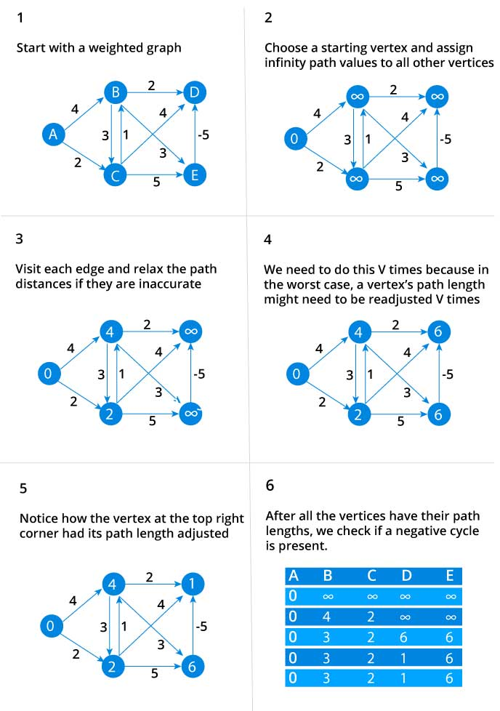

Slide 5
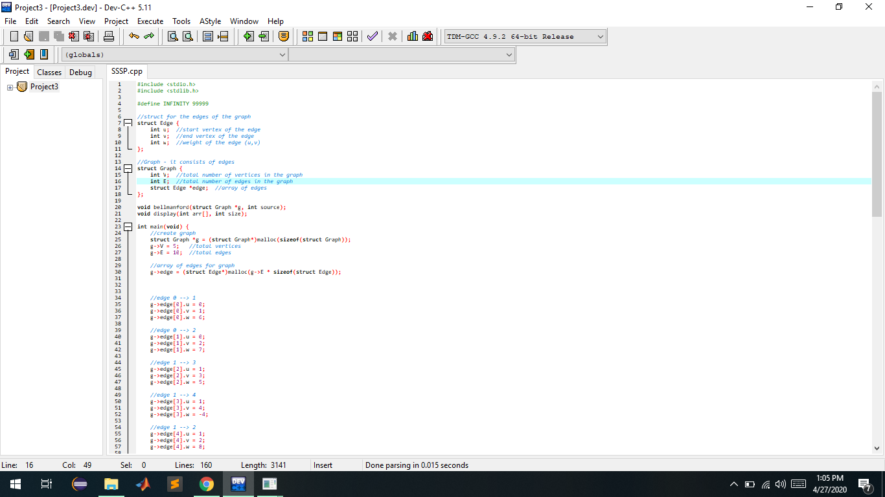
Code-

Slide 6
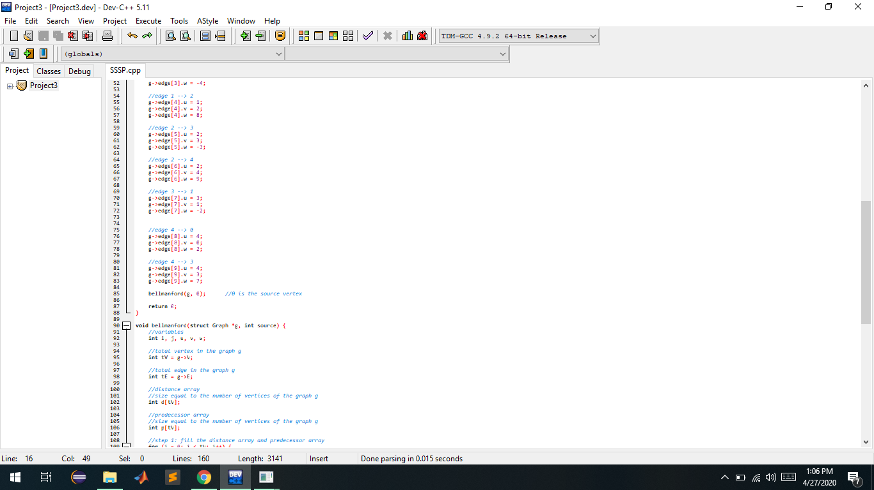

Slide 7
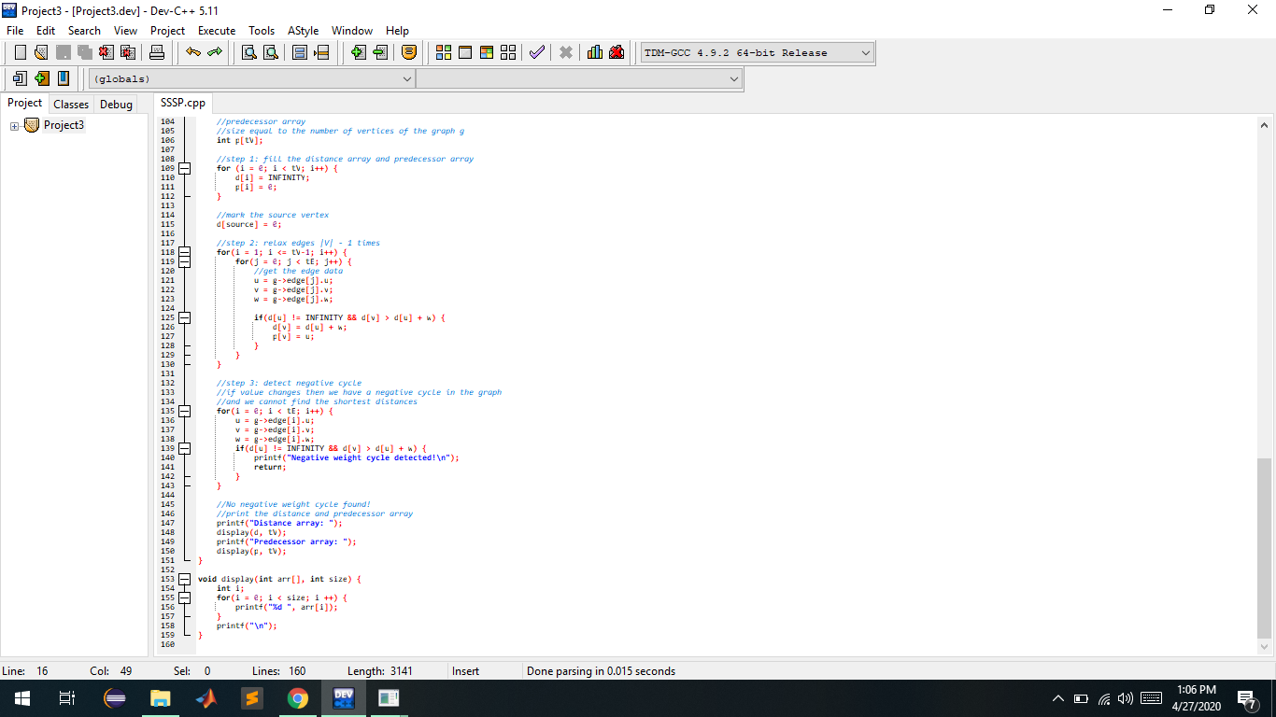

Slide 8
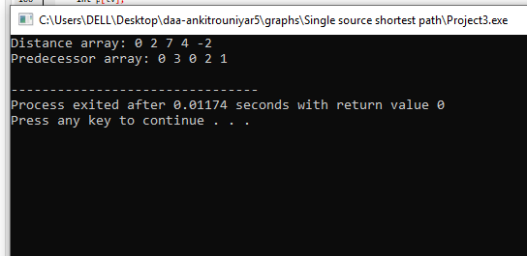
Output-

